Slide 1
Optimization Problems
Optimization: In the real world, there are many problems (e.g. Traveling Salesman Problem, Playing Chess ) that have numerous possible solutions.
Finding the optimum solution, which has the minimum cost, is the main goal of the optimization. In most of the case, searching of the entire solution space is practically impossible.
Optimization Problems classification:
. Static : Constrains remain fixed during the computation and after that.
. Dynamic: Constrains vary during the computation or after finding the
optimum solution.

Slide 2
Problem
Solution
Using
Static
Optimization
Dynamic
Optimization
Correct the solution
Change in problem
Fig 1: Static and dynamic optimizations

Slide 3
Dynamic optimization
Definition: Problems constrains and elements are changed after solving
the problem.
Goal: To find the new optimum solution in the best way (the worst way
is to solve the problem from the scratch)
Current techniques:
- Using memory: Storing the history of each peak for further exploration.
- Editing the solution: Modifying the last optimum solution.
- GA (adaptive mutation): Increasing the mutation rate after each change.
- Multi-Population GA: Keep tracking of each pick by a sub-population
(i.e. an island)

Slide 4
Optimization Problems Applications:
Vehicle routing
Good delivery
Large scale scheduling and transportation (i.e. Army logistics)
Characteristics of dynamic optimization environments:
Elements and conditions change by the time.
Optimum solution change by the time.
Computation time is high.
Example:
Traveling Salesman Problem (TSP) for Good delivery

Slide 5
Genetic Algorithms, strength and drawbacks
GA : Inspiring from genetic engineering to improve a generation of the chromosomes (i.e. solutions) and result excellent genomes (i.e. solutions).
Solution 1
Generation 1
Generation 2
Generation m
Chromosome 1
Chromosome 2
Chromosome n
Chromosome 1
Chromosome 2
Chromosome n
Chromosome 1
Chromosome 2
Chromosome n
Evolution
Xover
Mutation
Replacement
Selection
….
Fig 2: Genetic Algorithm

Slide 6
Why GA for optimization ?
GA is
Able to cover the solution space widely
Easy to hybrid with other algorithms (e.g. Local search)
Flexible and suitable for dynamic environments
Limitations of basic GA
. Still no guarantee for optimum solution (i.e. premature convergence)
. High computation time

Slide 7
Advanced GA
Adaptive GA: Auto adjusting the GA operators according the evaluation
of the chromosomes in each generation
Initialization
Evolution of individuals
Next generation
Evaluation of convergence rate
GA Parameters
adjustment
Final solution
Fig 3: Adaptive GA

Slide 8
Advanced GA (Cont.)
Parallel GA:
- Independent/Dependent multi-population GA
- Synchronized/Synchronized PGA
- P2P/Master-slave sup-populations
Problem
Sub
Population 1
Sub
Population 2
Sub
Population n
….
Best solution
Fig 4: Parallel GA

Slide 9
Advanced GA (Cont.)
Hybrid GA: Using a greedy algorithm (i.e. Local Search) to improve the
quality of individuals in each generation
Initialization
Evolution of individuals by GA
Next generation
Exploitation by heuristic search
Evaluation of individuals by GA
Final solution
Fig 5: Hybrid GA

Slide 10
Advanced GA (Cont.)
Multi-level GA: Splitting the problem into the small sub-problems and
merging the sub-solutions
Original problem
Clustering
Sub-problem 1
Sub-problem 2
Sub-problem 3
PGA
Sub-population 1
Sub-population 2
Sub-population 3
Merging
Master Population
Final solution
Fig 6: Multi Level GA

Slide 11
IGA for optimization
What is IGA (Island-based GA) ?
IGA is a multi-population GA in which chromosomes can migrate between the islands (sup-population).
Island 1
migration
Island 3
Island 2
Island n
Fig 7: Island Based GA

Slide 12
IGA for optimization
IGA (Island-based GA) characteristics:
Customized multi-population (i.e. Islands)
Synchronized and P2P migration (i.e. ring topology)
Adaptive operators:
- Local operators (mutation, crossover and hybrid rate)
- Global operators (migration rate, migration period)
Selectable hybrid (e.g. GA+LS, GA+TS, GA+SA)
Using two method crossovers dynamically (i.e. one and two point)
Auto-controlling “Occurrence” of each chromosomes to prevent the
saturation of the population.

Slide 13
Injection starts and stops periodically
Tour
Cost
Pop 1 (without remote injection)
Pop 2 (without remote injection)
Pop 1 (with remote injection)
Pop 2 (with remote injection)
Generation no
Fig 8: Periodically remote chromosomes injection prevents a common convergence

Slide 14
Initial global variables
Read the benchmark
Receive the best solution so far from each island
Calculate the costs
Islands
Start
Generate the islands
Show the results
Send the global variables
to each island
Has the last island
sent the results ?
No
Run islands in parallel
Yes
Stop
Fig 9: IGA main algorithm

Slide 15
Initial the population
Selection
Cross over and mutation
Send the best individual
to the controller
Local search
New population
Migration
(send/receive chromosome)
Evaluation of population
& parameters adjustment
Fig 10: IGA algorithm for an island

Slide 16
Advantages of IGA
Due to multi-population characteristic of IGA, the possibility of
getting stuck with local optimums is less in IGA than a single-population GA.
For lowering the computation time, each island may reside on a machine.
Periodically migration of chromosomes between the islands lowers chance of
premature convergence.
Adaptive operators, improve the performance.
Using a multi-method algorithm (i.e. hybrid) takes most advantage of the different
search techniques.
Each island can use different operator values (population size, mutation
rate and etc). This increases the diversity of the chromosomes and
decreases similarity of the islands.
PGA are more flexible when dealing with dynamic environments.
IGA has a better performance (i.e. in terms of quality of results) than
regular PGA.

Slide 17
Implementation and results so far
Using TSP as Benchmark
Evaluating and tuning the GA operators in static benchmarks, including:
- Local operator: Mutation and Crossover rates
- Hybrid operators: Method and rates
- Global operators: Rate and period of immigration and no. of islands
Creating a “Dynamic benchmark generator” that can periodically change
the distances between the cities
Observation of the system reactions (best fitness) to the dynamic
changes

Slide 18
Implementation and results so far (Cont.)
Generalizing the optimum values of the operators from static to the
dynamic environment
Evaluating the performance of the algorithm (results) by a factor (i.e.
improvement average cost) that has a consistent values, in addition to
“Best cost”, which is random
A visualized output for evaluation of the algorithm
Evaluation of adaptive parameters

Slide 19
Evaluation of IGA
For evaluation of IGA two comparisons have been done:
Comparison of pure and hybrid IGA (quality and Computation time) to
verify the preferred algorithm.
Comparison of IGA with the traditional searching methods, in terms of
quality of the results and computation time, to evaluate the performance of
the IGA.

Slide 20
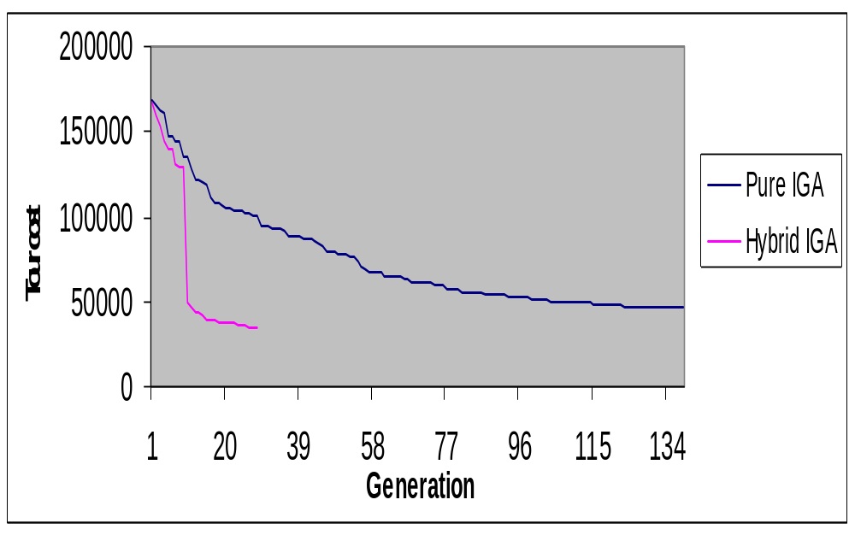
Fig 13: Comparison between pure and hybrid IGA

Slide 21
Comparison between IGA and other methods
Current Heuristic Methods:
Local Search (LS): A greedy algorithm that considers the best first change in the solution.
Simulating Annealing (SA): An algorithm that refers to the simulation technique in conjunction with an annealing (i.e. cooling) schedule of declining temperature.
Tabu search (TS): An algorithm similar to LS plus using memory to avoid repeating moves.

Slide 22
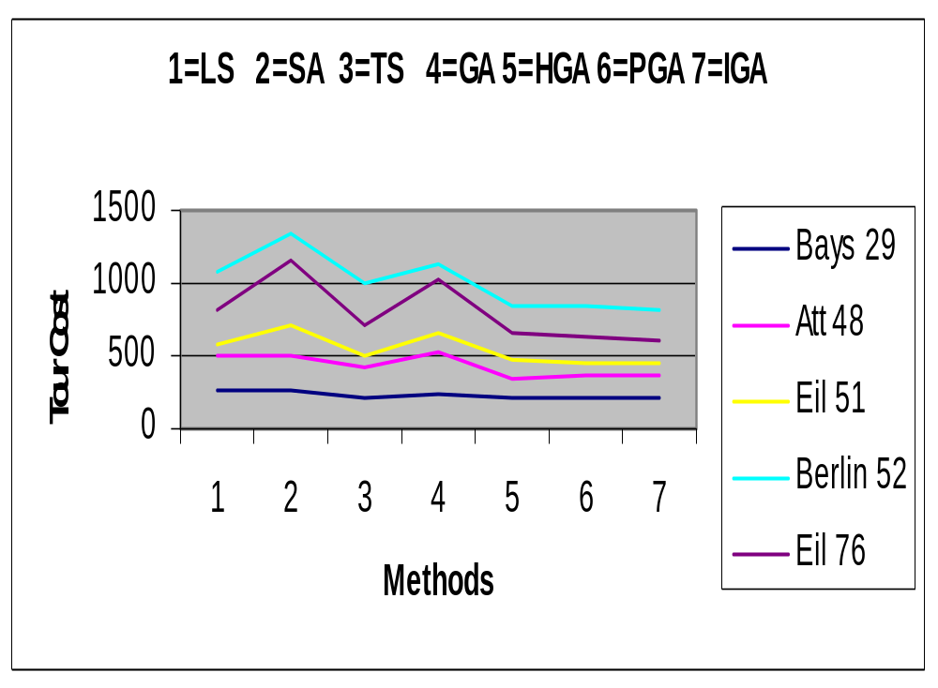
Fig 14: A comparison among the different search techniques

Slide 23
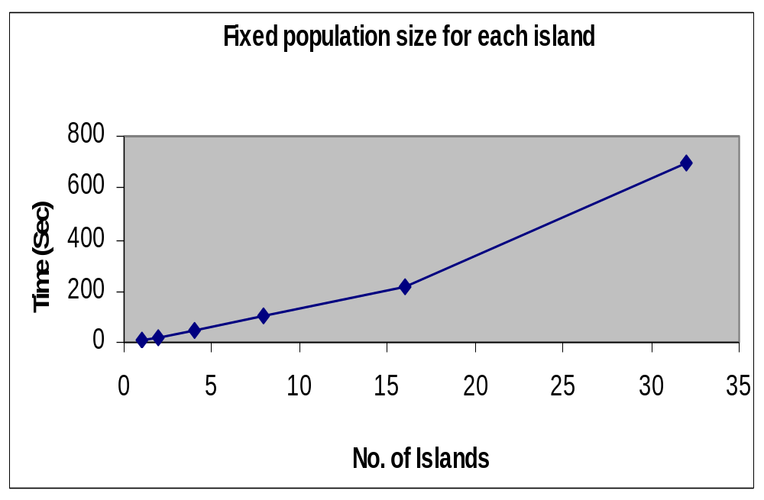
Fig 16: No. of Islands evaluation in terms of CPU time (IGA)

Slide 24
Results analysis and conclusion
Multi-population GA ,including IGA, have a better performance
compared with single-population GA.
Using a hill-climbing (i.e. Local search) method with GA (Hybrid GA),
improves the results considerably.
Migration of chromosomes lowers a premature convergence.
IGA can handle dynamic optimization problems better than plain
(single population) GA.
Optimum values for migration parameters (i.e. rate and period)
and also for number of the islands can be obtained for each benchmark.

Slide 25
Results analysis and conclusion (Cont.)
Variable crossover (one/two point) is better than fixed crossover.
Independent characteristic of the islands and cooperation among them can
handle changes in a dynamic benchmark better.
IGA has a better performance than traditional search methods (e.g. Local
Search, Tabu Search , Simulating Annealing) in term of efficiency (i.e.
quality of the results and considerable CPU time).
Migration in IGA helps to handle large benchmarks better.

